Slide 1
FRANCESCO SEBASTIANO MEMMOLA
50893A

Slide 2
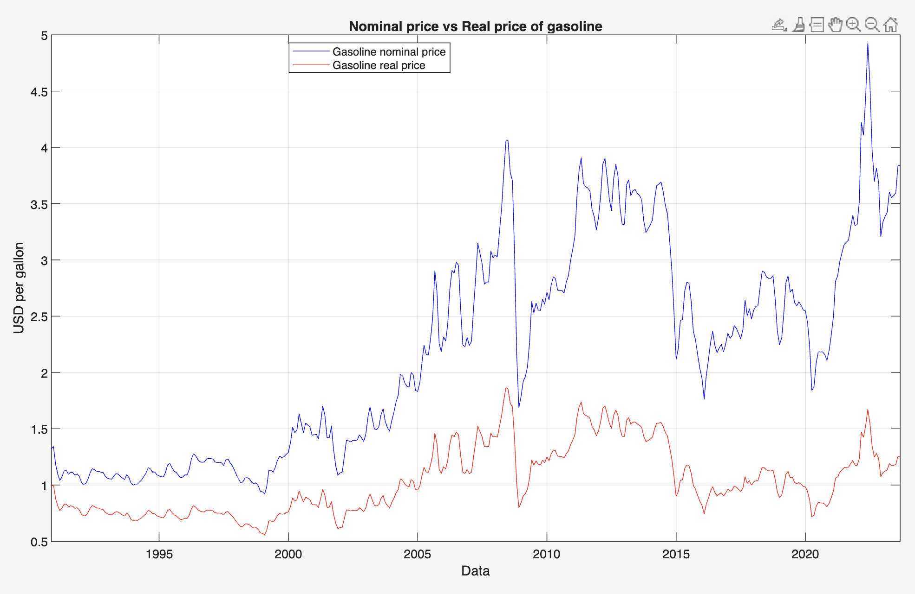
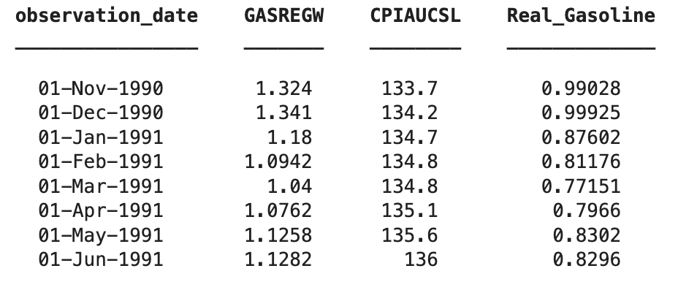
Real price gasoline

Slide 3
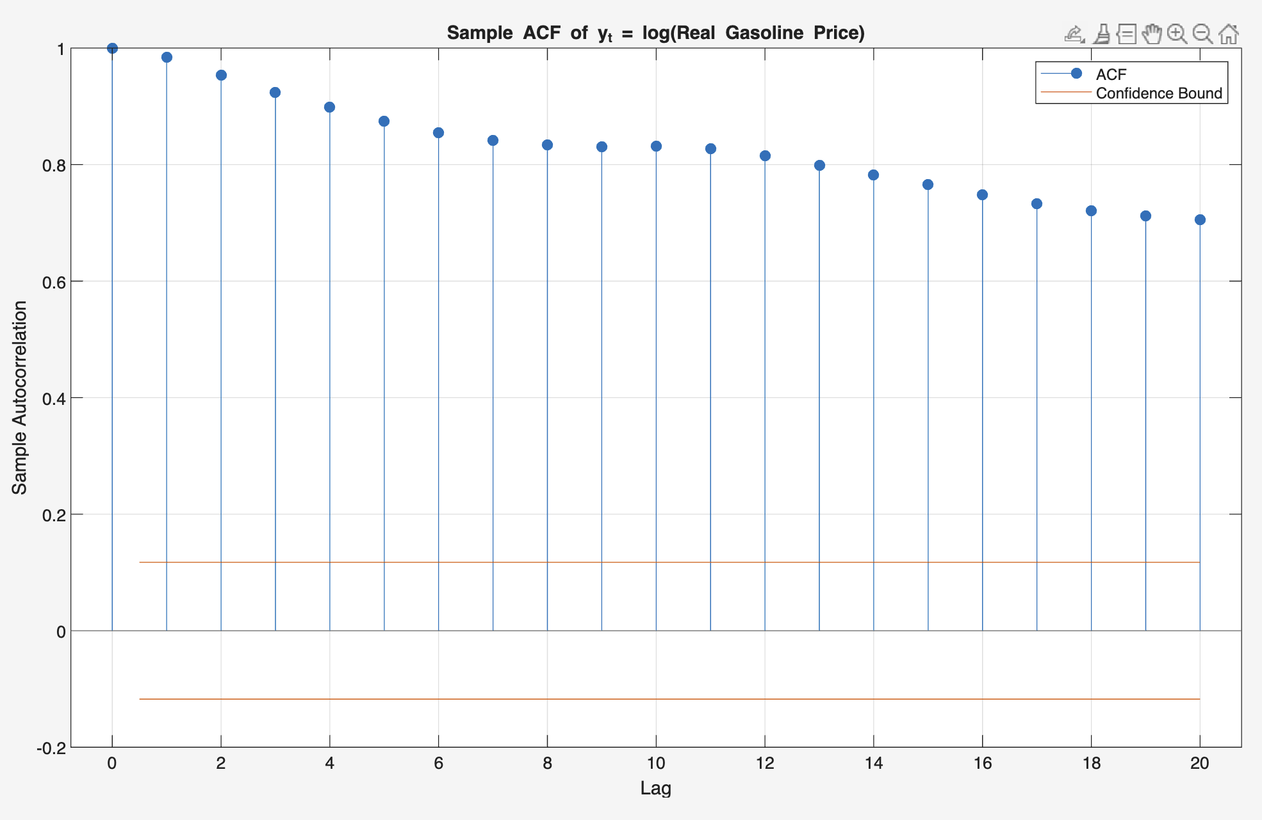
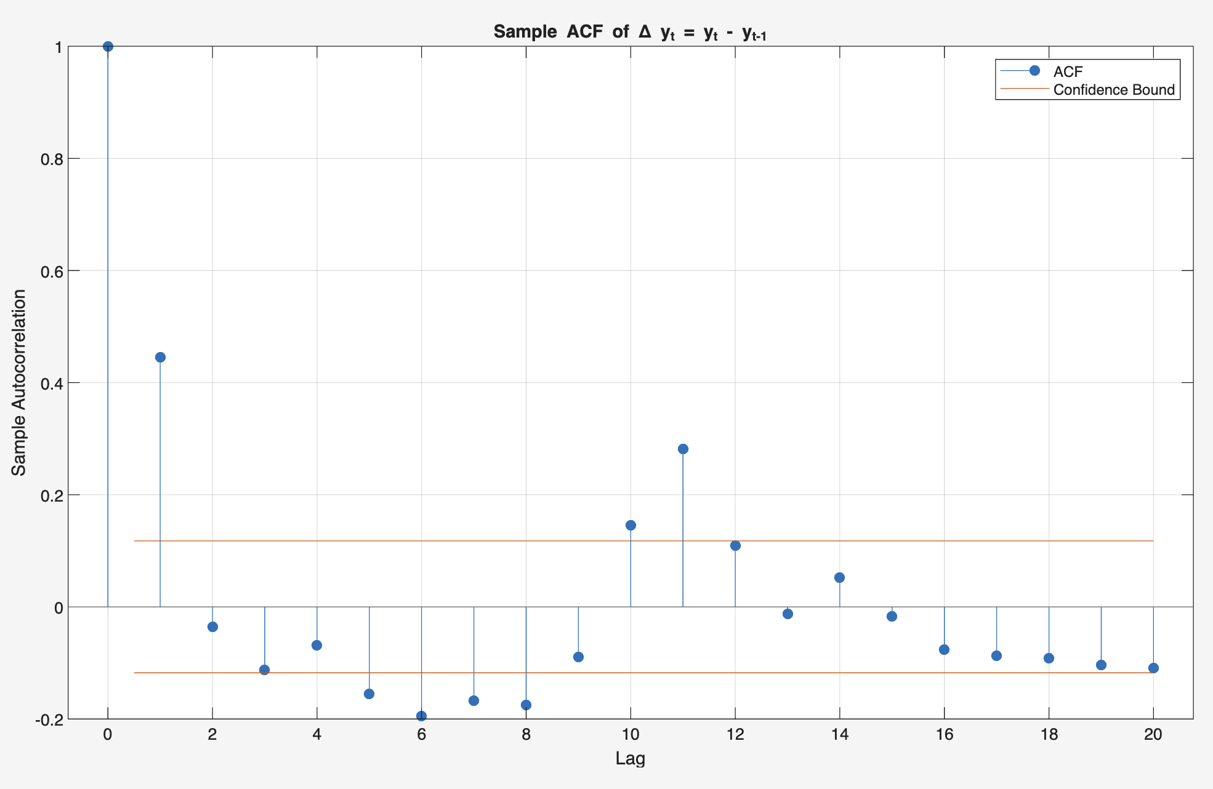
Sample ACF of log(Real Gasoline Price) and its First Difference
The ACF of y_{t} = log(Real Gasoline Price_{t} ) exhibits very slow decay, with autocorrelations remaining high and positive over many lags. This pattern indicates strong persistence and suggests that y_{t} is non-stationary, behaving like a random walk.
In contrast, the ACF of the first difference Δy_{t} = y_{t} - y_{t -1} drops sharply after lag 1 and fluctuates around zero, indicating that the differenced series is approximately stationary.
These results confirm that the log of real gasoline prices follows a process close to an integrated order one series, I(1) .

Slide 4
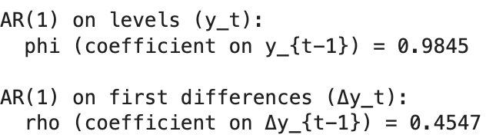
AR(1) Estimation for y_{t} and Δy_{t}
The AR(1) coefficient for y_{t} (0.9845) is close to 1, indicating near–unit-root behavior.
After differencing, the coefficient (0.4547) confirms stationarity with moderate short-term correlation.

Slide 5
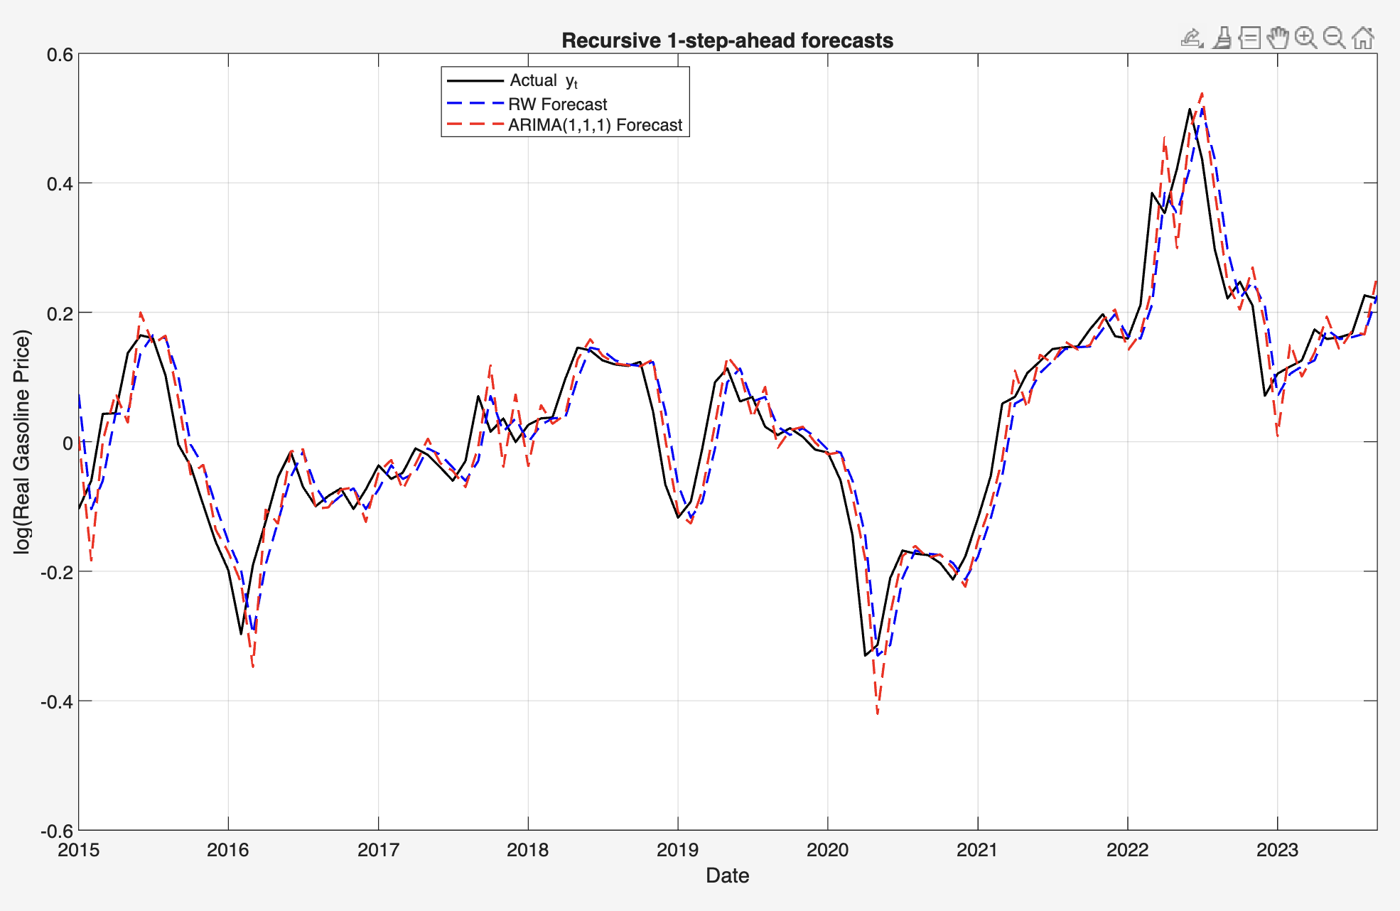
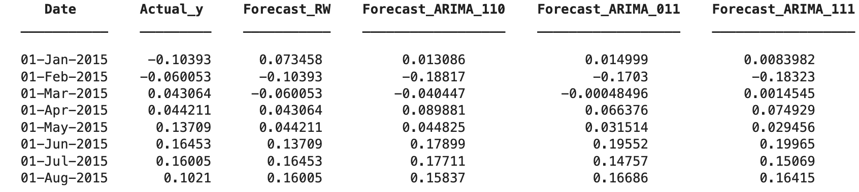
Recursive 1-Step-Ahead Forecasts for log(Real Gasoline Price)
All models produce very similar 1-step-ahead forecasts, closely tracking the actual log real gasoline price. The Random Walk serves as a strong benchmark, while ARIMA models only marginally improve short-term dynamics. This confirms that y_t is highly persistent and behaves almost like a random walk.

Slide 6
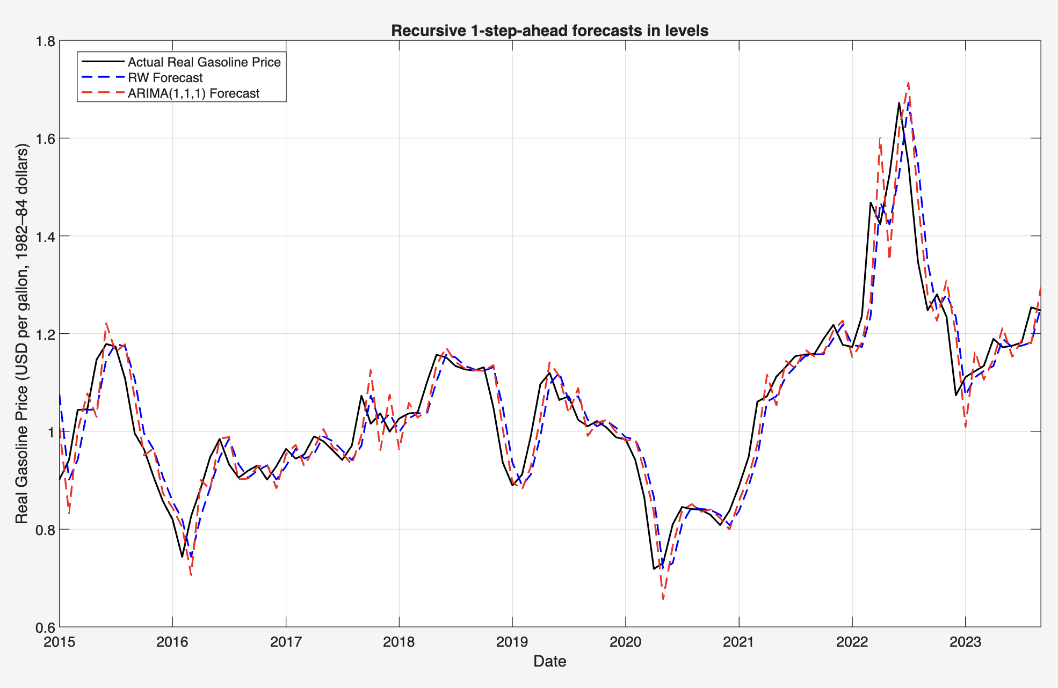
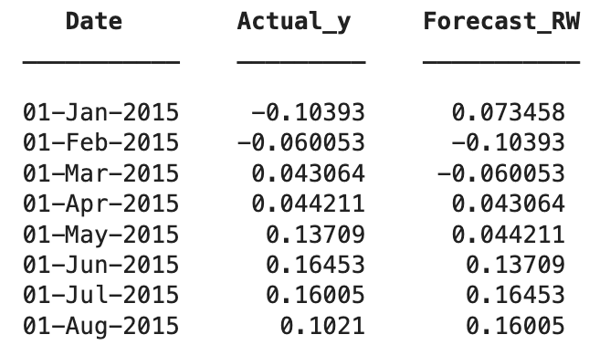
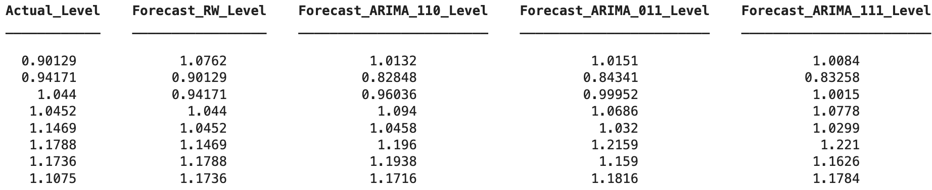
Transforming Forecasts to Real Prices (Levels)
The forecasts in levels track the realized real gasoline price very closely.
All models (Random Walk and ARIMA) are able to follow both medium-run movements and large spikes, so the transformation back to levels preserves forecast accuracy in economically meaningful units.

Slide 7
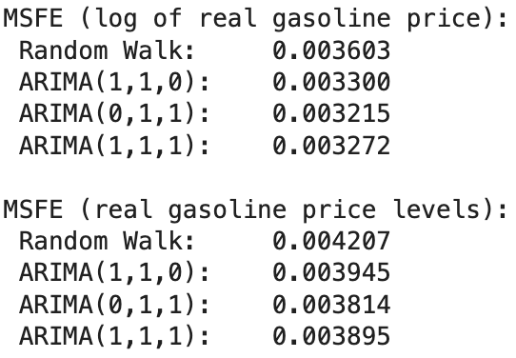
Mean Squared Forecast Error (MSFE) Evaluation
When forecasts are transformed back to real price levels, the ranking remains similar.
Again, ARIMA(0,1,1) yields the smallest MSFE, but the differences among models are minor.
This means that more complex models provide only modest gains compared to the Random Walk, which captures most of the variation due to the strong autocorrelation in the series.
The Mean Squared Forecast Errors (MSFE) indicate that all ARIMA specifications perform slightly better than the Random Walk, both in log and level forecasts.
The ARIMA(0,1,1) model provides the lowest MSFE, but the improvement is marginal, confirming that the real gasoline price behaves almost like a random walk, and simple models already achieve high predictive accuracy.

